Slide 1
API Test Integration
April 2016

Slide 2
Integration
With ALM
Normal API Test (QCIntegration)
Service Test Remote Agent (STRemoteAgent)
Service Test Remote Agent SSE (STRemoteAgent SSE) (Server Side Execution)
Server-side execution enables ALM to run UFT tests on remote hosts at predefined times without anyone logged in to the host to initiate and control the test runs.
In contrast, client-side execution requires a user to be logged in to the host computer on which ALM runs the UFT test.
BPT API Test (BPTIntegration)
BPT Remote Agent
With LoadRunner
LoadTesting (mdrv.exe)

Slide 3
QCIntegration
Folder in local: C:\Users\Administrator\AppData\Local\Temp\TD_80
Main Solutions:
ST\app\VTD\Extensibility\TechnologyImplementationExtensibility\app\STRemoteAgent
ST\app\VTD\Extensibility\TechnologyImplementationExtensibility\app\STRemoteAgentHelper
ST\app\VTD\Extensibility\TechnologyImplementationExtensibility\app\STRemoteAgentSSE (Server-side execution)
Entry point: RemoteAgent.cs with run() method
Process to attach: dllhost.exe

Slide 4
BPTIntegration
Folder in local: C:\Users\Administrator\AppData\Local\Temp\TD_80
Main Solution:
ST\app\VTD\Extensibility\TechnologyImplementationExtensibility\app\BPTRemoteAgent
Entry point: STBusinessComponentRemoteAgent.cs with run() method
Process to attach: ComWrapperRemoteAgent.exe

Slide 5
How to debug runtime
Set Environment's variable: ST_DEBUG = true
Attach to appropriate process
Turn on the log for RAs
For ST Remote Agent
Set Environment's variable: ST_DEBUG_LOGGING= true
Location logs: %appdata%\Roaming\Hewlett-Packard\UFT\Logs with file name format: RemoteAgentHelper-{yyyy-MM-dd_HH-mm-ss}.log

Slide 6
How to debug runtime (con’t)
Turn on the log for BPT Remote Agent
With ALM old versions <= 12
Go to ALM folder, find QCClient.QCExtension.UI.BPT.ExecutionSharedLibraryConfig.xml, open this file and change value of ShouldCreateLog to “true”, as the sample below: <?xml version="1.0"?> <BptRemoteAgentLogConfig xmlns:xsi="http://www.w3.org/2001/XMLSchema-instance" xmlns:xsd="http://www.w3.org/2001/XMLSchema"> <ShouldCreateLog>true</ShouldCreateLog> <LogFilePath>C:\BPTRALogs</LogFilePath> </BptRemoteAgentLogConfig>

Slide 7
How to debug runtime (con’t)
Turn on the log for BPT Remote Agent (con’t)
With ALM versions > 12
In ALM folder: Open ComWrapperRemoteAgent.exe.config: - Modify <threshold value="ERROR" /> to <threshold value="DEBUG" />. - The log will be on temp folder (%temp%) with comWrapperLog.log b. Open BptRemoteAgentApplication.exe.config and change from ERROR to DEBUG as above And the log will be on temp folder with bptRemoteAgent.log

Slide 8
Integration with LoadRunner
API Load Test Type (require to install LoadRunner on the same machine with UFT)
Main solutions
ST\app\VTD\Extensibility\TechnologyImplementationExtensibility\app\LoadRunnerAddin
ST\app\VTD\Extensibility\TechnologyImplementationExtensibility\app\LoadRunnerAddin\LoadRunnerRTAddin
Main functions: LoadRunnerTestLogic.cs with Save()method
Generating <test-name>.USR base on template Script.usr
Write Data Driven Files (xml/excel) to USR file

Slide 9
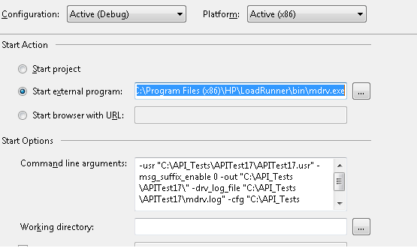
How to debug API load test
Attach to mdrv.exe from LR (C:\Program Files (x86)\HP\LoadRunner\bin\mdrv.exe)
Use command parameters in mdrv_cmd.txt
Modify the API project like as below

